Slide 1

Book Recommendation System
Department of Computer Science and Engineering
(Supervisor: Mr. Kedarnath Singh )
Group Members
Name of Member | Roll Number | Role
Satyam Pant | 1613310190 | Team Leader & Back-End Developer
Sahil Pandey | 1613310184 | Documentation & Front-End Developer

Slide 2

Index
Introduction
Literature Survey
Problem Statement
Proposed Methodology(Includes ER Diagram,DFD)
Hardware /Software Requirement
Proposed Solution
Modules(Screenshot/Video)
Conclusion
References

Slide 3

INTRODUCTION
A recommendation system is a subclass of information filtering system that seeks to predict the "rating" or "preference" a user would give to an item.
Recommendation systems are utilized in a variety of areas, and are most commonly recognized as playlist generators for music and video.
These systems can operate using a single input, like music, or multiple inputs within and across platforms like news, books, and search queries.

Slide 4
LITERATURE SURVEY
In year 2005 John O'Donovan ,Barry Smyth have taken trust as the percentage of correct predictions that a profile has made in general.
In year 2007 Paul Resnick proposed an idea of "influence limiter algorithm" in recommendation system.
Juan A. Recio-García presented a prototyping Recommender Systems in jCOLIBRI.

Slide 5

PROBLEM STATEMENT
Data is becoming one of the most important technology trends that have the potential for dramatically changing the way organizations.
All the traditional recommendation work has been evaluated and created for small data size.
The complete problem statement concludes into following points:
1. Enhancement in product recommendation algorithm for large volume dataset.
2. Integration of customer behavior with Product nature

Slide 6

PROPOSED METHODOLOGY
Recommendation systems usually make use of either or both collaborative filtering and content-based filtering as well as other systems such as knowledge-based systems.
Collaborative filtering approaches build a model from a user's past behavior as well as similar decisions made by other users. This model is then used to predict items that the user may have an interest in.
Content-based filtering approaches utilize a series of discrete, pre-tagged characteristics of an item in order to recommend additional items with similar properties.

Slide 7
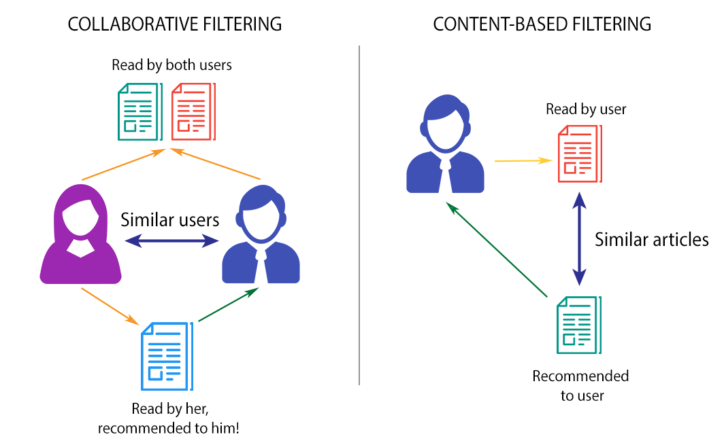
TYPES OF FILTERING USED:

Slide 8
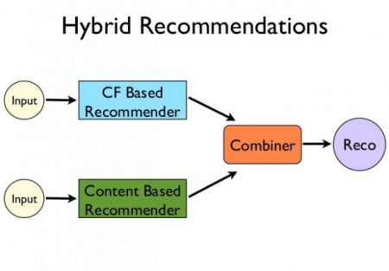
HYBRID RECOMENDATION

Slide 9
HARDWARE/SOFTWARE REQUIRED
Hardware Requirements: | Software Requirements:
System : Core i3 Processor | Operating System : Windows 10,Linux
Memory : 4 GB RAM | Programming Languages: Python,CSS,HTML,XML
ROM : 1 TB | Text Editor : Sublime Text
Display :1200*800 | IDE : Pycharm,Anaconda,Spyder

Slide 10

PROPOSED SOLUTION
Sometimes most libraries don't support scalable production systems out of the box, therefore some solutions are made to overcome these challenges:
Predicting dynamically
Optimizing response time
Frequently updating models
Predicting on unseen data

Slide 11
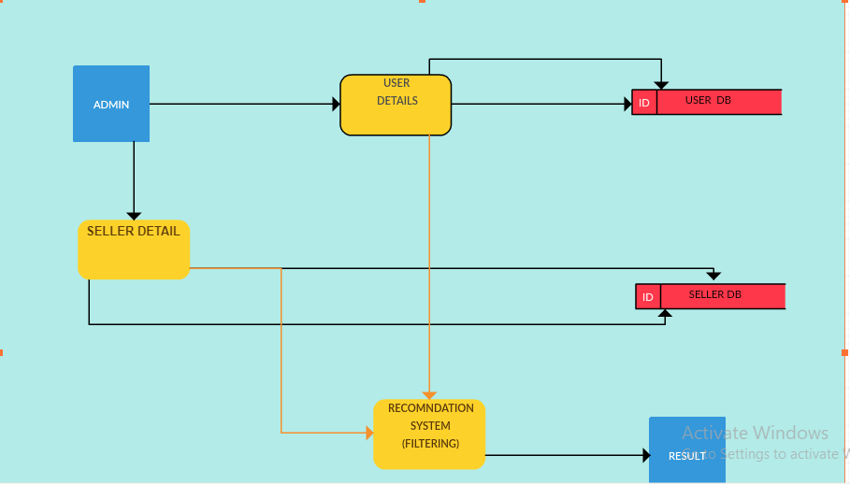
DESIGN PAGE(DFD)

Slide 12
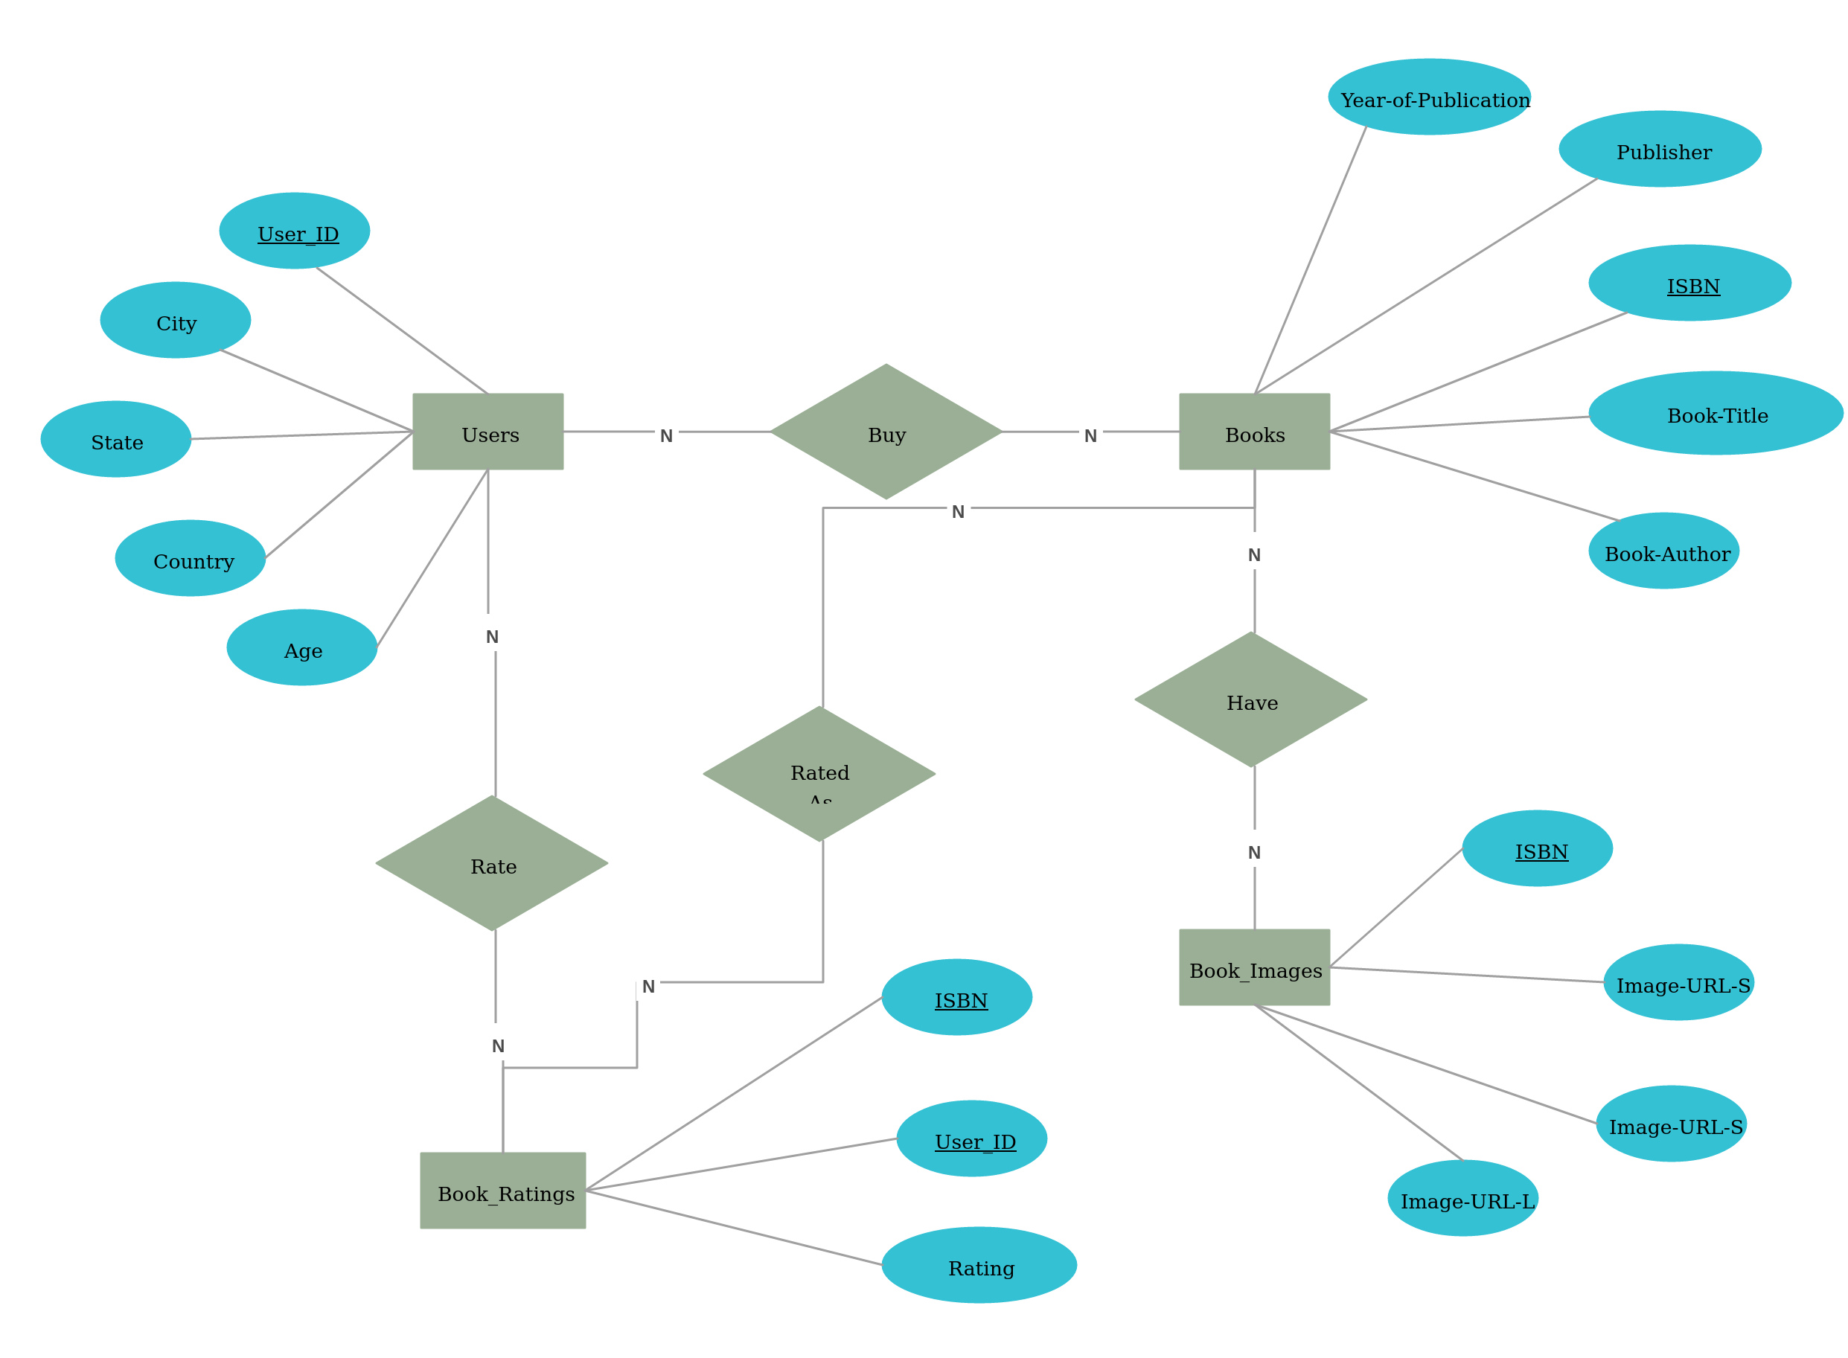
ER DIAGRAM

Slide 13
MODULES AND SCREENSHOTS
Sign in Details
uses email and password authentication for user login
Create an Account
Ask registration details
Home page
contains all the books and the information regarding books
Recommendations of Books and Analysis using graphs
Profile
contains the personal details of the loged in member
My Books
shows all the books read or kept by user in the directory

Slide 14
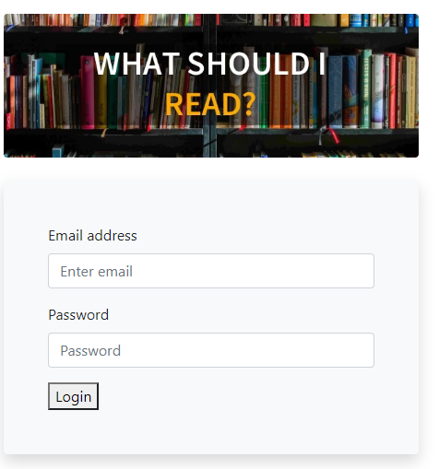
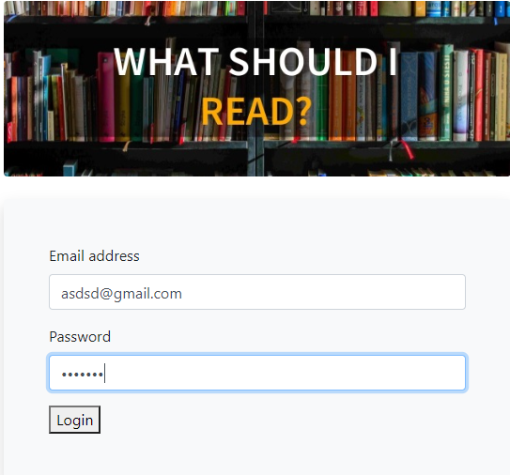
FIRST PAGE
Login Page

Slide 15
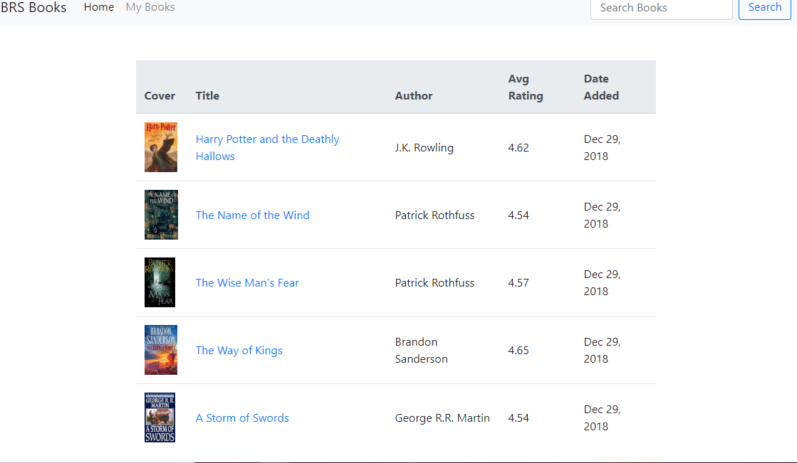
Books in the Directory

Slide 16
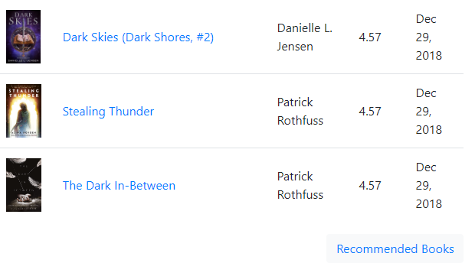
Recommended Books

Slide 17

Book Review Page

Slide 18
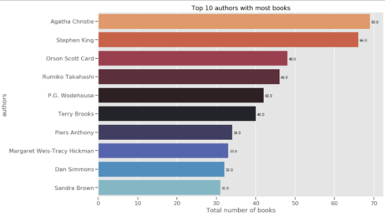
Top 10 Authors with most books

Slide 19
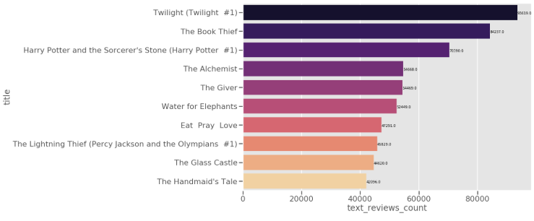
Books with highest reviews

Slide 20
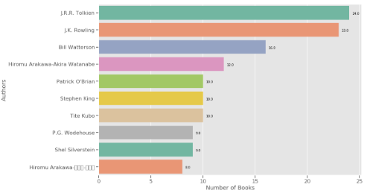
Highly rated Authors

Slide 21
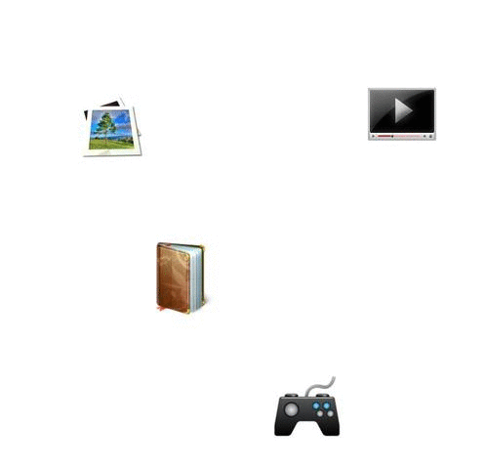
CONCLUSION
The complete work expects an integrated solution based on book characteristics and customer behavior for book recommendation. This project has attempted to explore the importance and need of book recommendation and also try to propose solution for same. The complete study proposes to implement this solution in future endeavor for standard dataset and evaluate the performance on basis of computation time and accuracy factor.

Slide 22

REFERENCES
[1] John O'Donovan , Barry Smyth, Trust in recommender systems, Proceedings of the 10th international conference on Intelligent user interfaces, January 10-13, 2005, San Diego, California, USA.
[2] Paul Resnick,"The Influence Limiter: Provably Manipulation Resistant Recommender Systems", RecSys’07, October 19–20, 2007, Minneapolis, Minnesota, USA. ACM.
[3] Ms. Praveena Mathew, Ms. Bincy Kuriakose, Mr.Vinayak Hegde, “Book Recommendation System through Content Based and Collaborative Filtering Method” published in IEEE International Conference on Data Mining and Advanced Computing (SAPIENCE), 16-18 March 2016.

Slide 23
Thank You

